Slide 1
Comparative Analysis of Task Configuration Scheduling Algorithms in Hadoop
Presented By Group PT3
Saurabh Somani
Aditya Randive
Caleb Fujimori

Slide 2
Topics
1. Three Important V’s (Volume, Variety, Velocity)
2. Hadoop & Overview of Hadoop Ecosystem
3. MapReduce
4. Factors determining Scheduling
5. Task Scheduling Algorithms with focus on factors
6. Improvement suggested for above 2 algorithms
7. Schedulers in Hadoop-MapReduce

Slide 3
3 V’s of Big Data
Volume - Problem of handling & storing data.
Variety - Data from different sources with different formats
Velocity - Data generated at huge speed and should be made available for speed processing

Slide 4
What is Hadoop?
Hadoop is a java open-source framework for distributed storage and processing on computer clusters with the very large data set.
Hadoop core consists of two parts:
Hadoop Distributed File System (HDFS) which is the storage part.
MapReduce as a processing part.
Files in Hadoop is split to smaller pieces (called blocks/chunks) its size is 64 MB or 128 MB, which are distributed over nodes in the cluster.

Slide 5
Why Use Hadoop?
Cheaper
Scales to Petabytes and more; just add commodity servers to the clusters
Faster
Parallel Data Processing
Better
Suited for particular types of Big Data
In Hadoop critical point is that you bring “computation” to “Data”. This is what makes Hadoop appealing along with parallel processing.

Slide 6
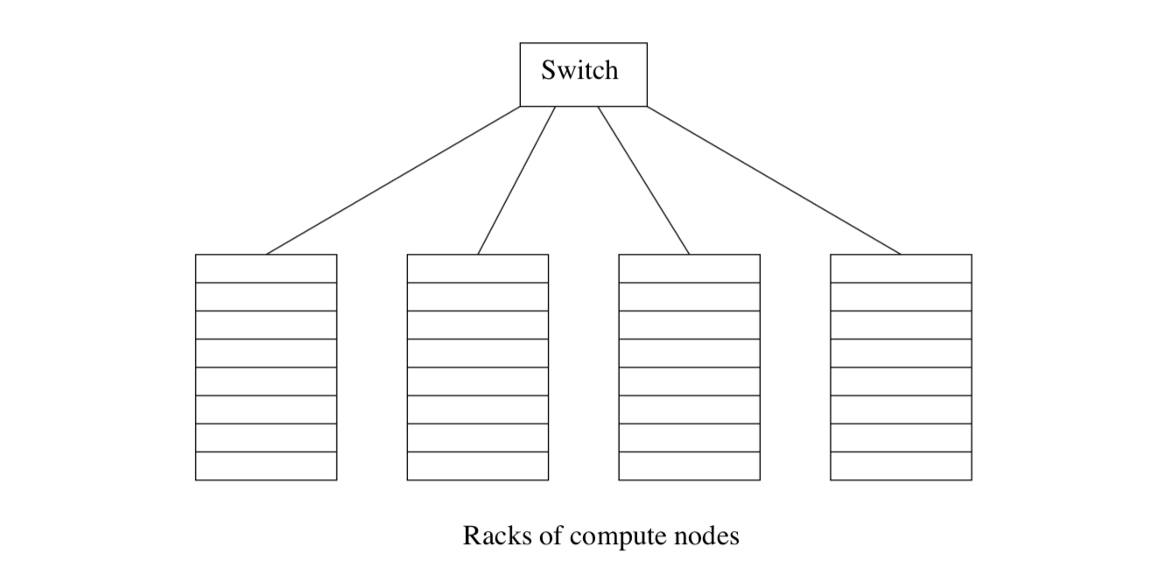
Nodes, Racks & Switch

Slide 7
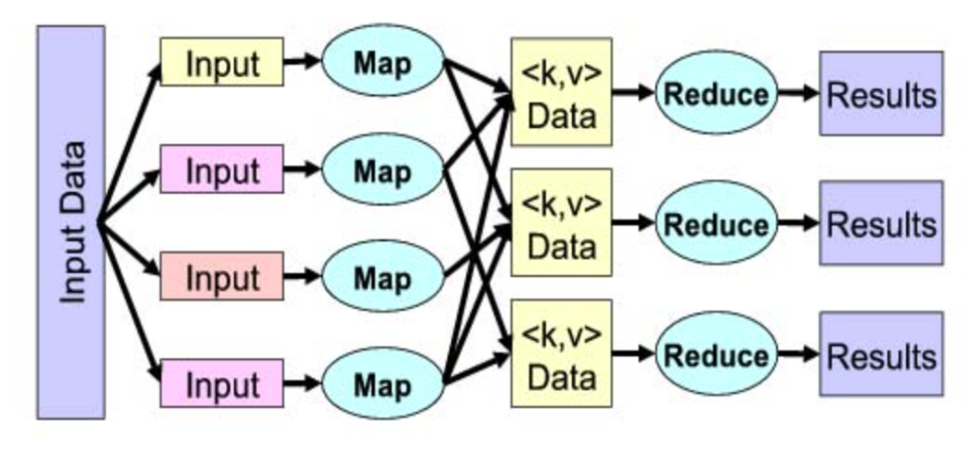
MapReduce

Slide 8
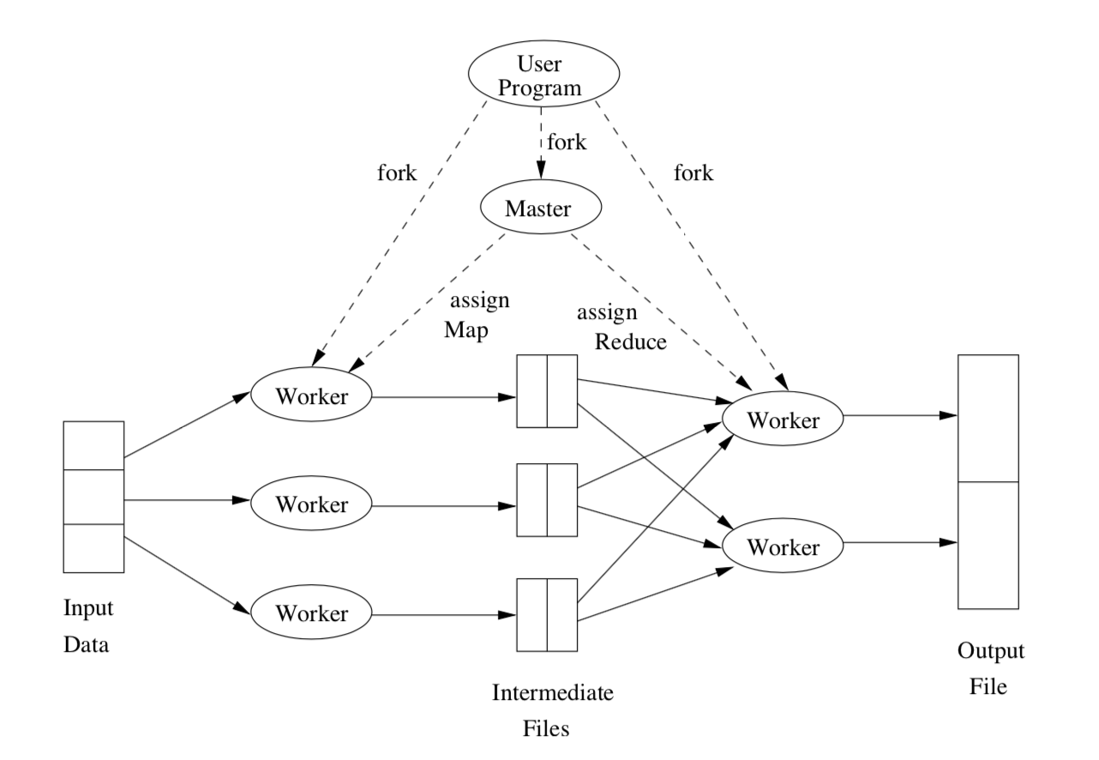
MapReduce (2)

Slide 9
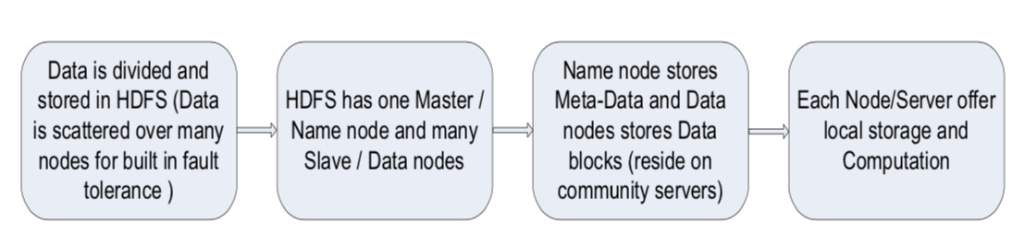
HDFS (Hadoop Distributed File System)

Slide 10
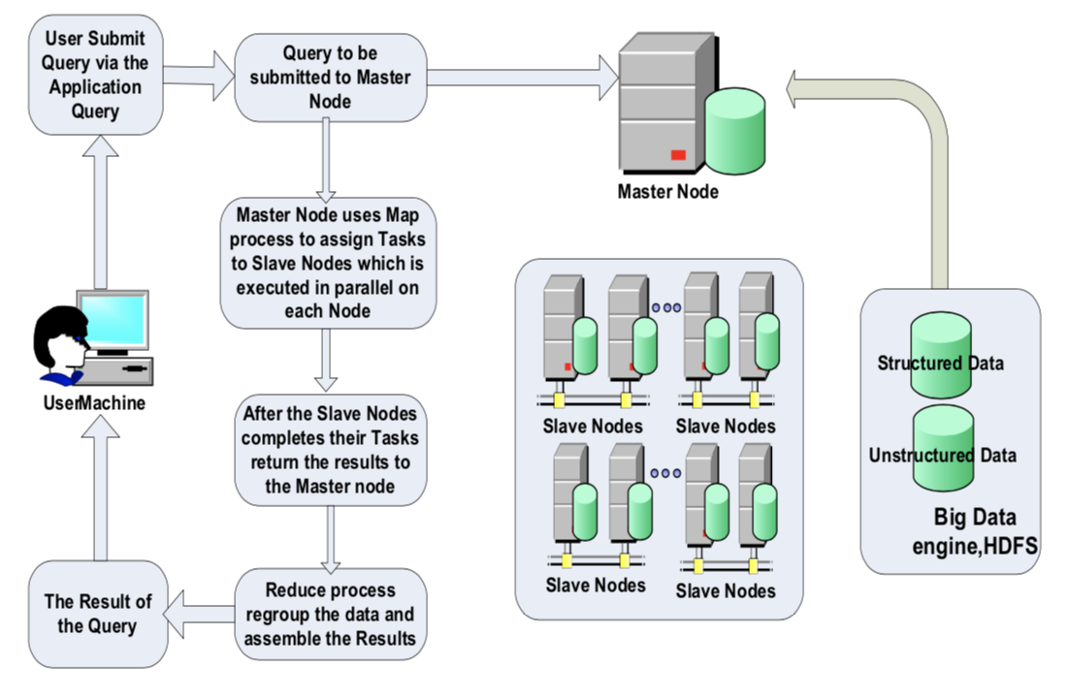
Hadoop Framework

Slide 11
Naming Conventions
Hadoop
Master node = Name Node
Holds meta-data, i.e, stores info about data-nodes
Slave/Worker node = Data Node
Nodes on which actual chunks of files are stored
MapReduce
Job Tracker = Yarn Resource Manager (MapReduce 2.0)
Task Tracker = Yarn Node Manager (MapReduce 2.0)
Slave/Worker node will either carry out a Map OR a Reduce task at a time, but not both at once !

Slide 12
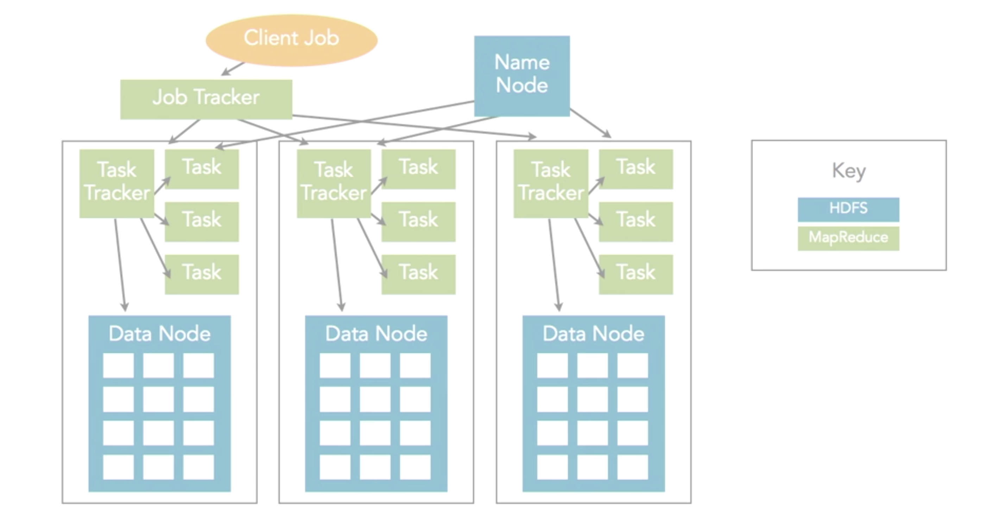
NameNode, DataNode, Job Tracker & Task Tracker

Slide 13
Factors
Locality
When the input data is closer to the node on which computation takes place, it causes a lower cost for data transfer.
Locality is a very important issue affecting the performance in a shared cluster atmosphere because the network bisection bandwidth is limited.
The most efficient case occurs when processing takes place on the same node where the data is stored.
But generally it is very difficult to get such a scenario because the requirements of jobs are different at different times which may not be satisfied by a nodes resources.
Hence , generally executing a task on same rack is preferred.

Slide 14
Factors (2)
Fairness
When we talk about large data, we know that the number of jobs received at an instant is very large.
Hence there has to be a way to ensure that the job which arrives first is executed first.
For example, we have loaded a node with many tasks and it is executing a heavy workload job now, in that case all the waiting jobs will have to wait which is unfair.
The demand of the workload can be elastic, so a load to each job sharing group should be considered.

Slide 15
Factors (3)
Workload
Every Task Tracker has a limit as to how many jobs can be executed at a time on it (we call them slots).
The number of slots is 2 by default and we can set it as per our case.
When Job Tracker assigns job to Task Tracker, it follows FCFS (First Come First Serve) strategy and so it creates possibility that a node may get overloaded whereas another is idle.
Hence there has to be an efficient way to do this assignment of jobs.

Slide 16
Data Locality Aware Scheduling
In application requiring large data processing, the input given to a map task can be expected to be much larger in size than the codes involved in the task performing.
To reduce the cost involved in transmission of data, the task is assigned in such a way that input data is closest to the node that requests the task.
Two things are considered while scheduling
Waiting Time
Transmission Time

Slide 17
Data Locality Aware Scheduling (2)
If the transmission time is longer than the waiting time, the locality aware scheduler is supposed to keep the task for the same node so as to take advantage of data locality.

Slide 18
Workload characteristic oriented Scheduling
Applications running on the same platform can have two types of characteristics
CPU intensiveness.
I/O intensiveness.
Tasks exhibiting the same resource utilization are more probable to being dispatched to the same machine.
Resource contention can occur in such approach which also leads to reduction in throughput.
WCO is different from other schedulers as it considers the diversity of applications whereas the earlier works consider only one type of MapReduce applications.

Slide 19
Workload characteristic oriented Scheduling(2)
WCO can detect the workload type by using a prediction mechanism which works on the basis of I/O rate.
It also uses a strategy in which it combines workload of different types and executes them on the same machine.
This improves the usage efficiency of CPU as well as I/O resource.
Computing rate ratio(CRR) has been used to characterize the task as CPU or I/O intensive.
If CRR approaches 1 then task is CPU intensive.
If CRR approaches 0 then task is I/O Intensive.

Slide 20
Workload characteristic oriented Scheduling(3)
For prediction of workload characterization an estimation process is used which consists of two phases:
Sampling
Adjustment
Sampling consist of two phases:
Task Selection
Done by Dynamic way. Strategies used are random & static analysis.
Generalization of workload characteristic.
Indicates tendency of resource utilization of a task.
Adjustment
Dispatching remaining tasks that were made to execute with other jobs which were found to have comparable workload characteristics.

Slide 21
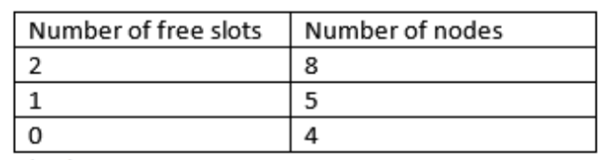
Improvement :Tabular Approach
Maintain a table for each Job Tracker.
Table displays number of free slots per node in the rack.
Allocate tasks according to the free slots to avoid overloading on a single node.
Once you have decided from the table which free node to select , apply data locality aware scheduling to increase data locality and achieve more efficient result.

Slide 22
Method | Description | Strength | Incorporating Proposed Tabular Form
WCO Scheduler | Characterization of jobs into I/O & CPU intensive. 2 phase estimation Sampling & Adjustment | Improvement in resource utilization and application performance Shows 17% performance improvement in terms of throughput | If no node is free, defer from queueing the job
Data Locality Aware | Computes waiting time using remaining execution time Divides tasks in smaller phases to ensure constant processing time | Out performs the native Hadoop Reduce task scheduler by an average of 7% to 11.6% Provides an efficient equation to calculate waiting time | It can be used to decide among the nodes having same number of free slots

Slide 23
Description for Tabular Approach | Strength
Maintains a table for each Job Tracker | Distributes Workload efficiently
Any scheduling of new job begins with lookup in the table | Ensures Fairness as each job is probable o be finished in appropriate time
Table has to be updated every time a job is scheduled or a scheduled job has been completed | Helps improving the efficiency of existing algorithms

Slide 24
Hadoop-MapReduce Schedulers
FIFO scheduler
First in first out (FIFO) is the default scheduling for Hadoop operates using a FIFO queue.
Tasks are ordered (after the job partitioning to individual tasks) by the assignment order to the TaskTracker nodes in turn to the free slots and scheduled with the same order.
FIFO scheduler reduces the data locality.
It does not considers the priority of the task.
Smaller user queries will wait for unfair time to get a result.

Slide 25
Hadoop-MapReduce Schedulers (2)
Fair Scheduler
Facebook aimed to achieve fairness between tasks by developing the Fair scheduler by trying to assign a resource for each task by equal fair sharing.
Fair scheduler makes the tasks with less execution time to be finished faster by using the equal share.
Each user has his pool with a minimum share of resources and uses the idle slots by allocating active tasks.
By default Fair Scheduler lets all applications run, but it can limit the number of running applications per user queue using the config file.
This can help in case of a user must submit many applications at once, also improve performance by minimizing intermediate data creation or context-switching. apps will not fail, but only will wait in the scheduler’s queue until some of the user’s earlier apps finish.

Slide 26
Hadoop-MapReduce Schedulers (3)
Capacity Scheduler
Yahoo developed capacity scheduler.
It is designed for large cluster shared by multiple organizations where there are a large number of users, developed to ensure the fair allocations of the computation resources between users and control job allocation based on physical machine resources.
Several queues are created instead of pools, the allocation of the jobs based upon users queue to configure MapReduce queue slots numbers.
The cluster capacity is shared between users, not between jobs as in Fair scheduler.

Slide 27
Hadoop-MapReduce Schedulers (4)
Delay Scheduler
Delay scheduling is used by Facebook.
The delay here come from waiting for a particular amount of time for the data on the local node to be present otherwise if not available skip and continue subsequent jobs.
The advantage, it solves the fair sharing locality problem.
In case of a job to be scheduled next and cannot launch a local task, it will be limited to an amount of time and let other jobs launch its tasks instead.
Goal from Delay scheduler is to statistically multiplex clusters while having a minimal impact on fairness and achieving high data locality.

Slide 28
Scheduler | Advantages | Disadvantages | Remarks
FIFO | Easy to be implemented | Bad data locality , small job will wait long time, starvation, no fair resources sharing. | Homogeneous System, Static allocation, non primitive
FAIR | Fair and equal share of resource allocation. Short response time with a small delay due to complex calculations | Complex settings, unbalanced workload because of no job weight | Homogeneous, static allocation
CAPACITY | Unused capacity used by jobs n the queue | More complex in implementation | Homogeneous, static, non-primitive
DELAY | Simplified Scheduling, No affect of complex calculations | Doesn’t works in all situation, not optimal sharing of resources | Homogeneous, static allocation

Slide 29
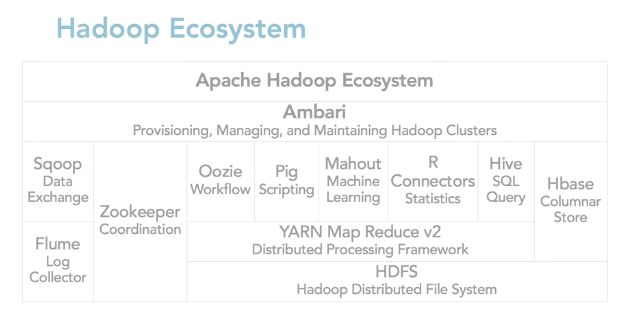

Slide 30
References
Mining of Massive Datasets by Jure Leskovec Stanford Univ., Anand Rajaraman Milliway Labs, Jeffrey D. Ullman Stanford Univ.
A. Maheshwari, A. Bhardwaj and K. Chandrasekaran, "Hadoop Task Scheduling - Improving Algorithms Using Tabular Approach," 2015 Fifth International Conference on Communication Systems and Network Technologies , Gwalior, 2015, pp. 1034-1038.
E. Mohamed and Z. Hong, "Hadoop-MapReduce Job Scheduling Algorithms Survey," 2016 7th International Conference on Cloud Computing and Big Data (CCBD), Macau, 2016, pp. 237-242.
S. Liu, J. Xu, Z. Liu and X. Liu, "Evaluating task scheduling in Hadoop-based cloud systems," 2013 IEEE International Conference on Big Data , Silicon Valley, CA, 2013, pp. 47-53.

Slide 31
Deadline Scheduling
Given a batch of jobs with deadlines
Real-time jobs or as part of service agreement
Schedule jobs and parts of jobs to meet deadlines
Job: Word Count Job: grep
Phases: Map Reduce
Tasks
Map words 0-100
Count # of “foo”

Slide 32
Deadline Task Scheduling
Tasks in phase have unequal execution time
Data size, network congestion, busy machine, HW problem
Outliers can increase median completion time by 34%
Duplicate tasks
Change nodes
Still have to consider resource utilization

Slide 33
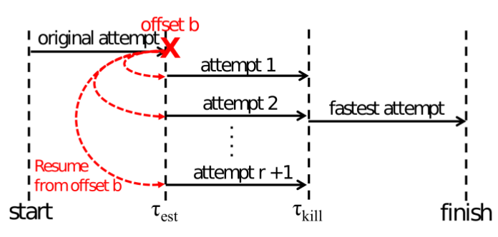
Deadline Task Scheduling: Speculative Resume
Algorithm Overview:
Run one attempt
At time t_{est} calculate PoCD R(r) and E_{r}(T)
Decide how many new attempts to launch
At time t_{kill} find attempt with most progress
Kill other attempts

Slide 34
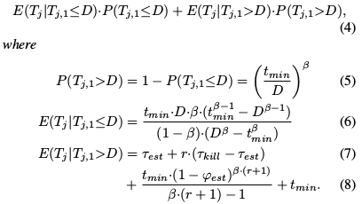

Deadline Task Scheduling: SRQuant
Analytical Speculative Resume Strategy
To decide # of attempts r:
calculate PoCD( R(r) ) and Expected Completion Time( E_{r}(T) ) for all r
Assume execution time T follows a Pareto Distribution (t_{min},𝛽)
φ_{est} = Progress at t_{est}
N = # of tasks in job
Notes:
Pareto: Pr(X>x) = {1 if x<xmin, (xmin/x)^alpha else}

Slide 35

Deadline Task Scheduling: SRQuant
θ=arbitrary tradeoff factor between execution cost and meeting deadline
C=cost per execution time
Find r to maximize utility U(r)
Meeting Deadline vs Cost

Slide 36
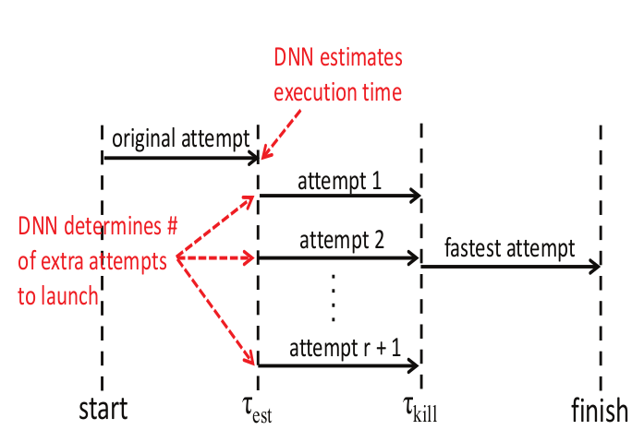
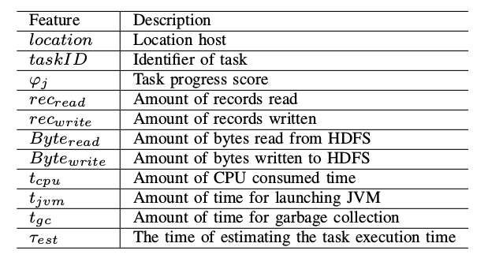
Deadline Task Scheduling: LASER
DNN based Speculative Resume
One DNN to estimate execution time
Another DNN to determine number of extra attempts

Slide 37
Deadline Task Scheduling: Comparison
Comparison of LASER and SRQuant to default Hadoop Scheduler
PoCD LASER: +40% SRQuant: +89%
Cost LASER: -18% SRQuant: -13%

Slide 38
Deadline Task Scheduling: Improvements
Duplicating tasks does not always lower execution time
Really big task
Duplicating tasks prevents other tasks from running
(Re)schedule task to better machine Spread Reduce tasks to spread Traffic Place task close to data
Replicate Intermediate Data In case of HW failure

Slide 39
Deadline Task Scheduling References
M. Xu, S. Alamro, T. Lan and S. Subramaniam, "LASER: A Deep Learning Approach for Speculative Execution and Replication of Deadline-Critical Jobs in Cloud," 2017 26th International Conference on Computer Communication and Networks (ICCCN), Vancouver, BC, 2017, pp. 1-8.
G. Ananthanarayanan, S. Kandula, A. G. Greenberg, I. Stoica, Y. Lu, B. Saha, and E. Harris, “Reining in the outliers in map-reduce clusters using Mantri.” in OSDI, vol. 10, no. 1, 2010, p. 24.
D. Cheng, J. Rao, C. Jiang and X. Zhou, "Resource and Deadline-Aware Job Scheduling in Dynamic Hadoop Clusters," 2015 IEEE International Parallel and Distributed Processing Symposium, Hyderabad, 2015, pp. 956-965.
J. Dean and S. Ghemawat, “Mapreduce: simplified data processing on large clusters,” Communications of the ACM, vol. 51, no. 1, pp. 107–113, 2008.

Slide 40
Why Scheduling?
Multiple “tasks” to schedule
The processes on a single-core OS
The tasks of a Hadoop job
The tasks of multiple Hadoop jobs
Limited resources that these tasks require
Processor(s)
Memory
(Less contentious) disk, network
Scheduling goals
Good throughput or response time for tasks (or jobs)
High utilization of resources
40
Notes:
40

Slide 41
Hadoop Scheduling – A history
"Have you no Hadoop Etiquettes" (2007) (reducer count capped in response)
User takes down the entire Cluster (OOM) (2007-2009)
Bad Job slows down entire cluster (2009) //billions of rows - out of memory
Steady State latencies get intolerable //prevent memory outage but slow
"How do I know I am getting my fair share" (2011)
"Too few reducer slots, cluster idle"
41
Notes:
41

Slide 42
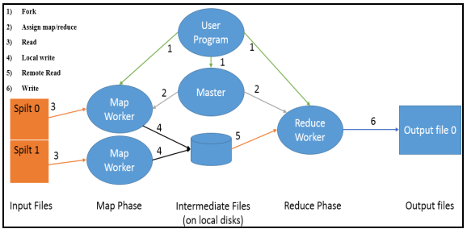
Execution of a MapReduce Job

Slide 43

Perfect Scheduler
Efficient
Scalable
Strong Isolation
Fair
Fault Tolerant
Low latency
43
Notes:
43

Slide 44
Single Processor Scheduling
10
Which tasks run when?
Task 1
Processor
5
Task 2
Task | Length | Arrival
1 | 10 | 0
2 | 5 | 6
3 | 3 | 8
3
Task 3
Arrival Times 0 6 8
44
Notes:
44

Slide 45
Parametric Evaluation of Job Scheduling Algorithms
Evaluation Parameter | Data Locality | Synchronization overhead | Fairness | Average Response Time | Job Execution Time | Average Waiting Time
FIFO Scheduler | High | More | Low | Low | Low | High
Fair Scheduler | Medium | Fair | High | Less | Medium | Moderate
Capacity Scheduler | Medium | Fair | High | Less | Medium | Moderate
LATE Scheduler (Longest approximate time to end) | Low | Low | Low | Low | Low | Moderate
Resource Aware Scheduler | Medium | Fair | Medium | Less | Medium | Moderate
Matchmaking Scheduler | Medium | More | Medium | Medium | Medium | Moderate

Slide 46
Job-Aware Scheduling
Limitations of existing scheduling algorithms:
*Limited Utilization of computing resources
*Limited applicability towards Heterogeneous cluster
*Random scheduling of non-local map tasks
*Negligence of small jobs in scheduling
46
Notes:
46

Slide 47
Job-Aware Scheduling
Ensures decrease in Average Waiting Time
Job execution time
Earliest Deadline first
Ensures efficient utilization of resources
Workload of the job
47
Notes:
47

Slide 48
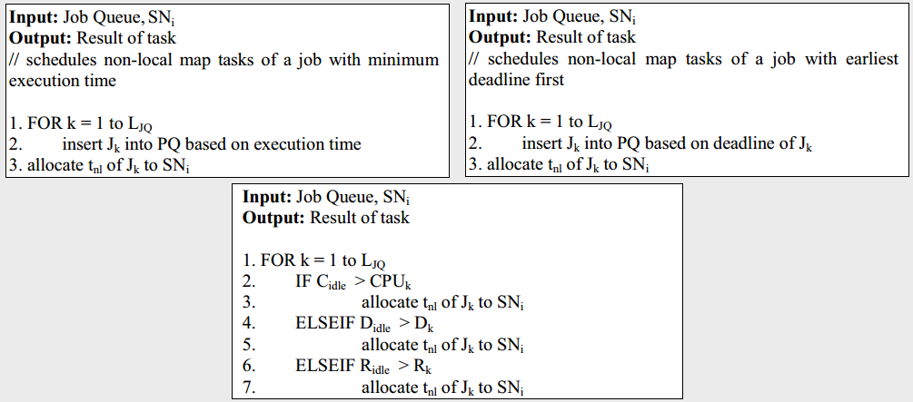
Job-Aware Scheduling

Slide 49
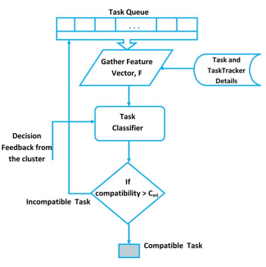

Mathematical Analysis
CPU-intensive, Memory-intensive, Disk-intensive, Network-intensive

Slide 50
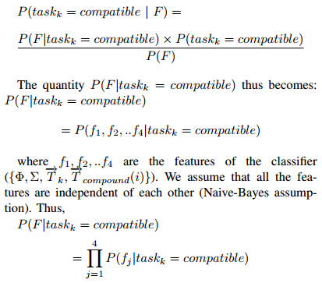

Mathematical Analysis
Incremental Naïve-Bayes
Interfaces:
LISP
PROLOG

Slide 51
Preemption: Problems
* Single Job Tracker for all Jobs
-Does not scale
* Poll based Architecture
- Scalability and Low latency at permanent war
- Inefficient - leaves idle time
* Slot Based Scheduling
- Inefficient
* Pessimistic Locking in Tracker
- Scalability Bottleneck
* Long Running Tasks
- Fairness and Efficiency at permanent War
* Preemption is wasteful
Mappers>>Reducers
Reducers>>Mappers
51
Notes:
51

Slide 52
Pessimistic Locking vs Optimistic Locking
getBestTask():
for pool : sortedPools
for job : pool.sortedJobs()
for task : job.tasks()
if betterMatch(task) …
processHeartbeat()
synchronized(world);
return getBestTask()
52
Notes:
52

Slide 53
Pessimistic Locking vs Optimistic Locking
getBestTask():
for pool : sortedPools
for job : pool.sortedJobs()
for task : job.tasks()
if betterMatch(task) …
processHeartbeat()
synchronized(world);
return getBestTask()
Task[] getBestCandidates():
for pool: sortedPools
for job: pool.sortedJobs.clone()
for task: job.tasks.clone()
synchronized(task):
processHeartbeat()
tasks = getBestTaskCandidates()
synchronized(world)
return acquireTasks()
53
Notes:
53

Slide 54
